Slide 1
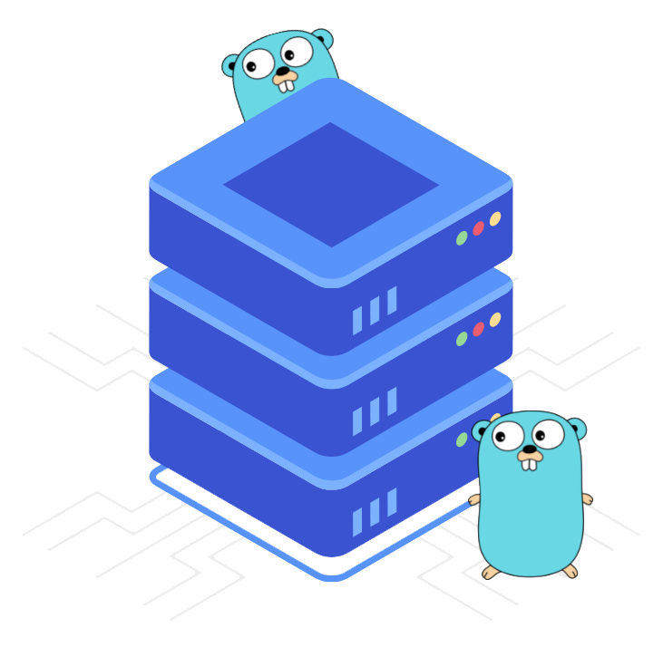
Programming with Golang

Slide 2

Module 1:
Introduction to Go Programming

Slide 3


COURSE OUTLINE
Lesson 1
1. Introduction to Go
2. Programming Concepts in Go
3. Control Statements
4. Setting up the Go Environment

Slide 4
Topics
History of Golang
About Golang

Slide 5
Learning Objectives
By the end of this lesson, you will be able to:
Describe Golang and its features
Understand the need of Golang in IT
Explore the motivation behind the creation of Go

Slide 6
History of Golang

Slide 7

Golang Origin
Go is a programming language created by Google engineers Robert Griesemer, Rob Pike, and Ken Thompson.
The development of Go began in September 2007.
It was officially announced in November 2009.
The first version of Go was Go V1.0 launched in March 2012.
The current stable version of Go is Go 1.20 released on February 1, 2023.

Slide 8
Go Releases
Go Version | Release | Description
Go 1 | March 28, 2012 | This is the first stable release of Go.
Go 1.6 | February 17, 2016 | This release had improved support for HTTP/2 and garbage collection.
Go 1.11 | August 24, 2018 | It introduced modules for dependency management and a more efficient garbage collector.
Go 1.14 | February 25, 2020 | This release featured improved runtime and support for macOS Catalina.
Go 1.16 | February 16, 2021 | This release added support for embedding files directly in the source code, improved type parameters, and performance improvements.
Go 1.19 | February 08, 2022 | The release added support for links, lists, and clearer headings in doc comments.
Go 1.20 | February 01, 2023 | This has extended development phase, broad testing feature, and improved overall stability of the code base.

Slide 9
About Golang

Slide 10
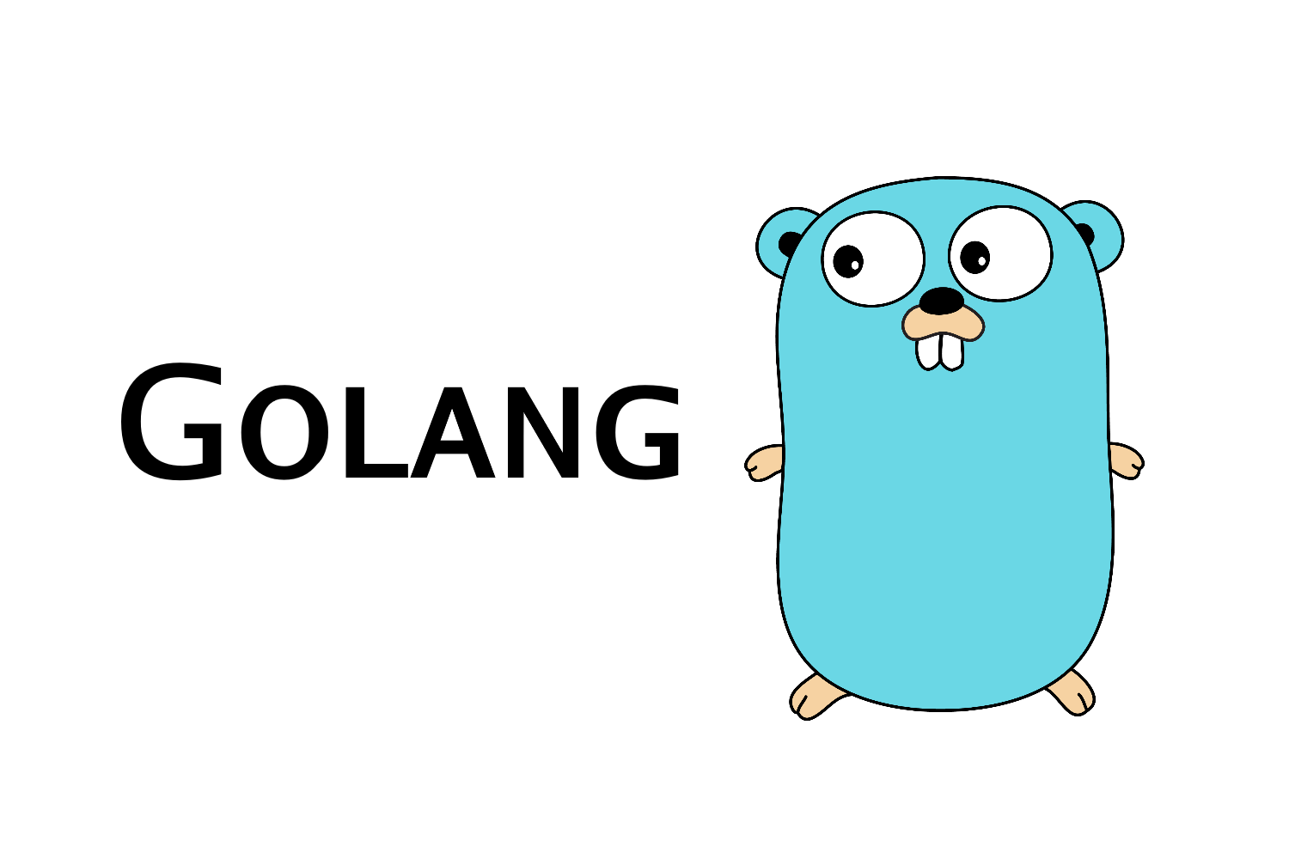
Golang
Golang is an open-source programming language that makes it easy to build simple, reliable and efficient software.
Go is natively combined, hence Go programs directly compile to machine code like C, C++.
Go has a clean syntax, hence it is targeted toward system programming and server-side programming.
It has excellent support for concurrency and networking.
Go compiler is available on Linux, OS X, Windows, various BSD, and Unix versions.

Slide 11









Companies Using Golang

Slide 12
Possibilities with Golang
Cloud and Network Services: With a strong ecosystem of tools and APIs on major cloud providers, it is easier than ever to build services with Go.
Command-line Interface: With popular open-source packages and a robust standard library, use Go to create fast and elegant CLIs.
Web Development: With enhanced memory performance and support for several IDEs, Go powers fast and scalable web applications.
DevOps and Site Reliability: With fast build times, lean syntax, an automatic formatter, and doc generator, Go is built to support both DevOps and SRE.

Slide 13
Need of Golang
The reasons for the need of a new programming language:
01
02
03
04
Compiles large Go program in seconds on a single computer
Light-weight as compared to other OO languages
Easy development of system software on multicore machines
Fully garbage collected

Slide 14
Summary
In this lesson, you have learned to:
Explore the history of Golang
Analyze Golang along with its features
Understand the need of Golang

